Slide 1
COMPRESSED SENSING IN MRI
HL2027
Ramadhani Pamapta PUTRA
Olivier MARION

Slide 2
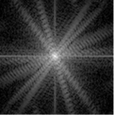
Compressed sensing?
INTRODUCTION :
MRI imaging machine send signals to the body and then receive the resulted signals back.
K-space frequency spectrum can be produced from the received signal.
K-space then converted into MRI image.

Slide 3
HOWEVER ,
MRI imaging has an acquisition time, which is not instant.
The acquisition time is relatively long.
Shorter acquisition?
Possible, but there are challenges :
Worse image resolution
Shorter range of image frequency

Slide 4
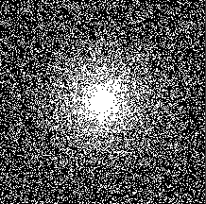
Compressed sensing?
Yes, this is where Compressed Sensing (CS) is needed.
Compressed Sensing (CS) :
Measure the body in smaller quantities, as we don’t need to sample everything in k-space.
More sampling in center of k-space, less sampling outer part of the k-space

Slide 5
Transform Point spread function experiments (Task3)
Incoherent aliasing interference in the sparse transform domain is an essential ingredient for CS
The PSF is a natural tool to measure incoherence
PSF(I,j) measures the contribution of a unit-intensity pixel at the ith position to a pixel at the jth position
MR images typically sparse in a transform domain rather than the usual image domain.
→incoherence is analyzed by Transform Point Spread Function (TPSF) which measures how a single transform coefﬁcient of the underlying object ends up inﬂuencing other transform coefﬁcients of the measured undersampled object.
The size of the sidelobes in TPSF(i; j, i!=j, → measure of the incoherence of a sampling trajectory

Slide 6
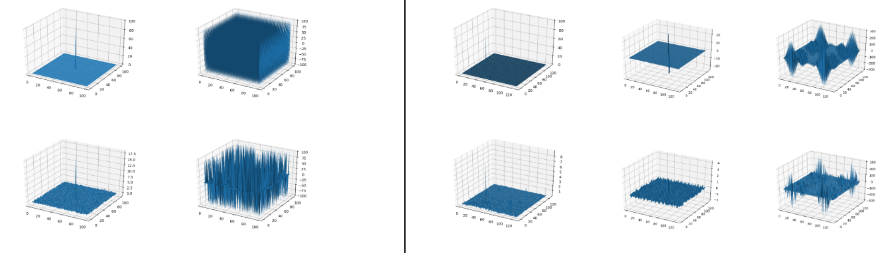
TPSF Experiments
PSF of pure 2D random sampling
looks random
Incoherent wavelet interference.
Not exactly the same as in the initial experiment. We want TPSF(i !=j) as small as possible

Slide 7
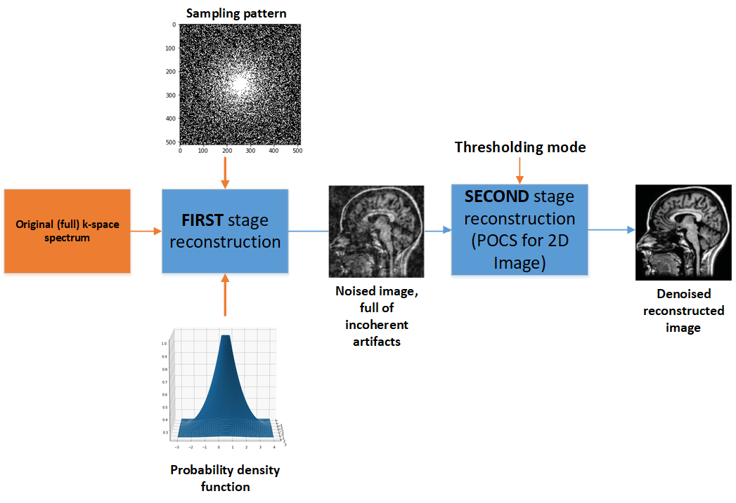
IMAGE RECONSTRUCTION EXPERIMENTS (TASK 4)

Slide 8
IMAGE RECONSTRUCTION EXPERIMENTS (TASK 4)
Independent variable#1
Independent variable#3
Independent variable#2

Slide 9
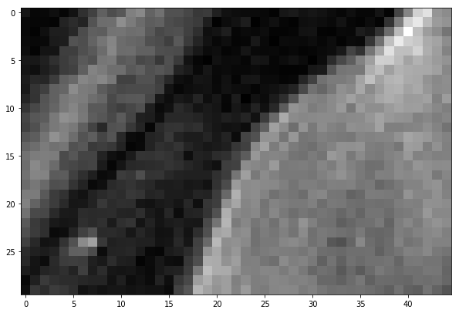
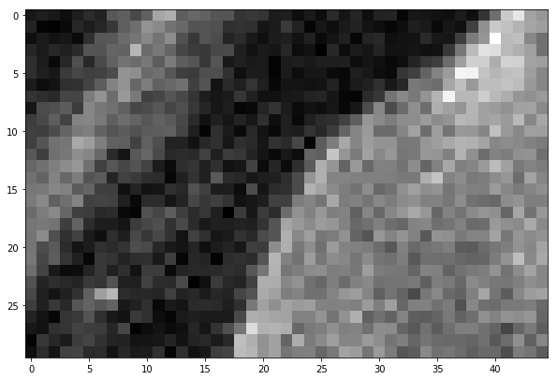
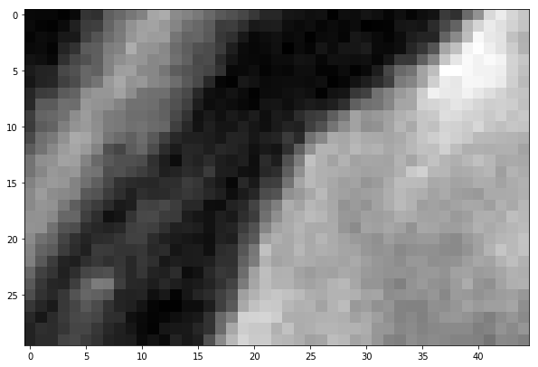
Image comparation
Original
FINAL RECONSTRUCTION
NOISED, FROM UNDERSAMPLING

Slide 10
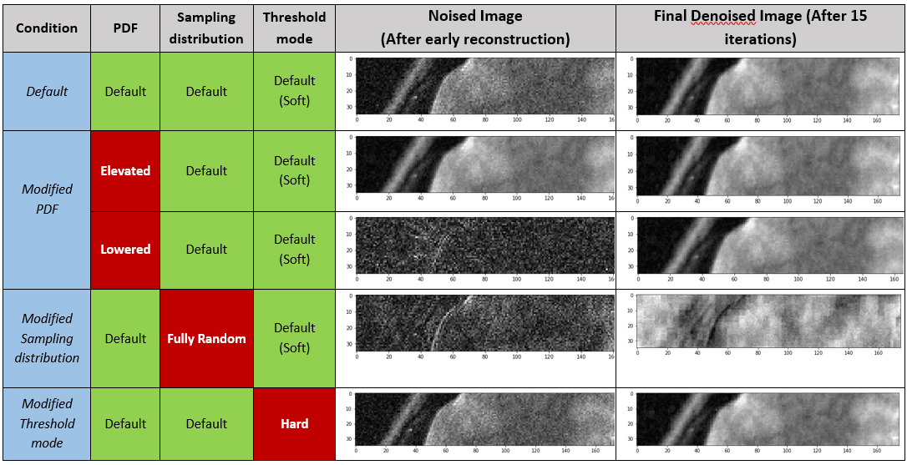
RESULT

Slide 11
REFERENCES
M. Lustig, D. Donoho and J. M. Pauly, "Sparse MRI: The Application of Compressed Sensing," Magnetic Resonance in Medicine, vol. 58, p. 1182–1195, 2007.
M. Lustig, D. L. Donoho, J. M. Santos and J. M. Pauly, "Compressed Sensing MRI," IEEE Signal Processing Magazine, pp. 72-82, March 2008.
https://radiopaedia.org/articles/mri-introduction

